Slide 1
Future key challenges on governance and compliance
October 2027

Slide 2
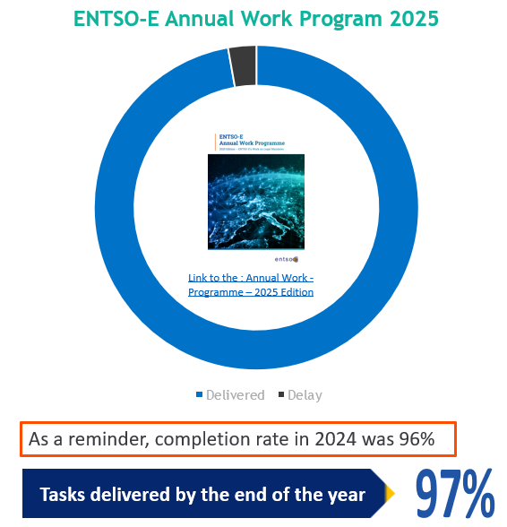
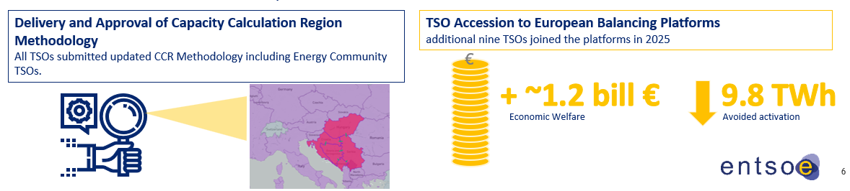
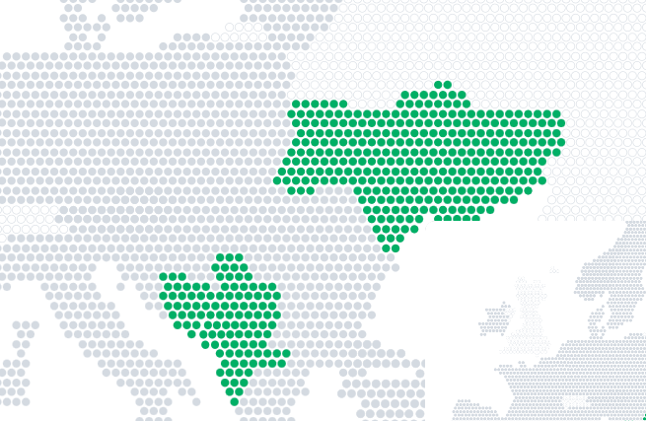
Future challenges on governance
Considerations on governance
Evolving the governance without compromising the security and resilience of the system.
Ensuring alignment with the roles and responsibilities of the different parties involved.
Defining not only the target but also implementable pathway(s).
Notes:
Main message: we are delivering today … so please consider for any governance proposal …..

Slide 3
Future challenges on governance
EU internal energy market saves consumers €32 billion in Day Ahead alone
Go live of the 15-Minute Market Time Unit in the Day Ahead Market
15-minute MTU went live on 30 September 2025 (trading day) .
Intraday Gate Closure Time Moved to 30 Minutes Before Real Time.
Uninterrupted continuation of day ahead market coupling across all participating bidding zones.
amended IDCZGOCT methodology was submitted by all TSOs in July 2025.
Market design reform implementation
completion of over one year of pan European testing
first operational go lives of the 30 minute gate closure occurred on 14 January 2026.
15min
Governance on the DA and ID Markets
Market coupling is critical infrastructure for the TSOs in balancing and dispatching the power system.
MCO function must be a joint responsibility of TSOs and NEMOs, covering technical, governance, and IT system aspects.
Notes:
Main message: Market coupling is working today and is critical infrastructure for TSOs … so please consider that MCO must be a joint responsibility in all aspects

Slide 4
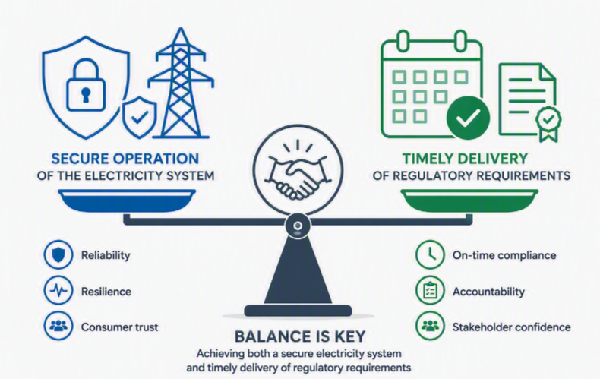
Future challenges on governance
Regulatory framework to foster the implementation
Clear regulation, smooth regulatory decision process with the engagement of all concerned parties are the factors for successful and timely implementation.
Implementation timelines are influenced by regulatory developments, methodological maturity, stakeholder alignment and technical feasibility – these are not sufficiently taken into consideration so far.
A comprehensive assessment of the factors influencing implementation timelines would help to define robust deadline.
Notes:
Main message: To deliver fast we need: clear regulation (ambiguity on the regulation due to misalignments between EU and MS like the principles to define structural congestion, cost sharing keys, or the need or not to have one or several methodologies today to monitor the 70% …. Do not help)
TSOs do have the role to maintain operational security: so between time and quality (secure operation)… no question about the choice

Slide 5
Market Stakeholders' interaction
Pan European
Across Timeframe
Market European Stakeholder Group
Pan European
Time frame specific
Market Coupling Stakeholder Group
CACM and FCA coordination group
EB Stakeholder Group
Demand Response Stakeholder Group
Regional
Regional implementation groups
Regional stakeholders groups
Regional implementation groups
Regional stakeholders groups
Regional implementation groups
Stakeholders' interaction
Efficiency on the reporting is important
Current framework fits for purpose – all timeframes and all geographical scope covered
Ad hoc workshop to be organised in case needed
Notes:
Main message: We need to be efficient and avoid having new foras that overlaps existing ones…

Slide 6
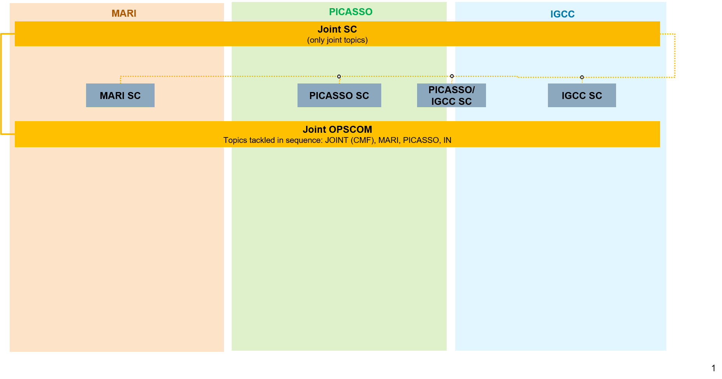
Joint Balancing platform governance
Not to be shared with ACER/internal back up slide

